Slide 1

GitHub Copilot
Zhu Yang & Nick

Slide 2
Agenda
What is GitHub Copilot
What can we do with GitHub Copilot
How GitHub Copilot understand your code
How to design your Copilot
How to quantify GitHub Copilot’s impact on developers
Summary
Insights
References

Slide 3
What is GitHub Copilot
GitHub Copilot is an AI-powered pair programmer that assists developers by providing context-aware code suggestions and autocompletions. It leverages the power of GPT (Generative Pre-trained Transformer), including the Codex model, to understand code context and generate code snippets in real-time. It serves as a valuable coding companion, helping developers write code more efficiently, reducing errors, and accelerating the development process.
Key words:
AI-powered pair programmer, context-aware code suggestions, autocompletions, GPT, Codex

Slide 4

What can we do with GitHub Copilot
Code Generation
Documentation Assistance
Code Autocompletion
Code Formatting
Error Handling
More…
Muli-Language Support
Unit Testing
Notes:
Code Autocompletion: Copilot provides context-aware code autocompletion suggestions as you type, helping you write code faster and with fewer errors.
Code Generation: It can generate entire code blocks, functions, classes, and more based on your context and requirements.
Documentation Assistance: Copilot can generate code comments and documentation for your code, making it easier for you and your team to understand and maintain the codebase.
Code Formatting: It can help with code formatting, adhering to best practices and coding standards.
Error Handling: Copilot can suggest error-handling code and provide solutions to common coding mistakes.
Multi-Language Support: It supports multiple programming languages and can assist in various development tasks, regardless of the language used.
Machine Learning Integration: GitHub Copilot can be particularly helpful for machine learning and data science tasks, as it can generate code for data preprocessing, model building, and more.
Version Control Integration: It integrates seamlessly with Git and GitHub, helping you manage version control and collaborate with others efficiently.
Unit Testing: Copilot can assist in generating unit tests for your code, ensuring better code quality and reliability.
IDE Integration: It's integrated with popular Integrated Development Environments (IDEs) like Visual Studio Code, making it accessible to a wide range of developers.
Customization: You can customize Copilot's behavior and preferences according to your coding style and project requirements.
Code Review: It can help in generating code for code reviews, ensuring that your code adheres to best practices and guidelines.
Learning and Improvement: GitHub Copilot continuously learns from the code you write, adapting to your coding style and becoming more effective over time.
Enhanced Productivity: By providing real-time code suggestions and reducing the need for manual coding, Copilot significantly enhances developer productivity.

Slide 5
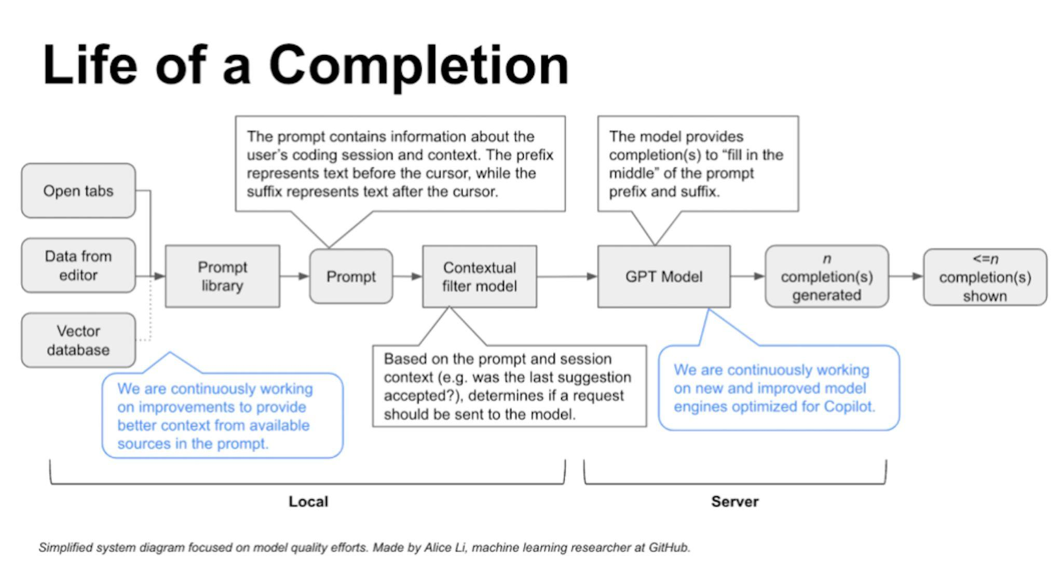
How GitHub Copilot understand your code
Notes:
矢量数据库：GitHub正在试验矢量数据库，以提供定制的编码体验，特别是对于私有存储库和专有代码。这些数据库使用嵌入来捕获关于代码片段的语义信息。算法为存储库中的所有代码片段创建嵌入，并将它们存储在矢量数据库中。编写代码时，该工具会将代码段嵌入IDE中，并在数据库中搜索代码段和代码段之间的近似匹配。
GitHub Copilot的“邻近标签”是一项功能，允许GitHub Copilot处理您的集成开发环境（IDE）中当前打开的所有文件，而不仅仅是您正在积极工作的单个文件。这个功能帮助GitHub Copilot从项目中打开的文件中收集额外的上下文，使其提供的代码建议更相关和准确。
当您在IDE中打开多个文件时，GitHub Copilot可以分析并考虑这些文件中的代码和上下文，以提供编码建议。这种增强的上下文理解可以导致更有帮助和与上下文相关的代码建议，最终提高您的编码体验和生产力。
实际上，邻近标签扩大了GitHub Copilot可以使用的信息范围，以帮助您完成编码任务，确保它考虑整个项目的上下文，而不仅仅是当前活动的文件。这个功能旨在使GitHub Copilot在理解和生成整个代码库上下文的情况下更加有效。
"Fill-In-the-Middle"（FIM）是GitHub Copilot使用的一种技术，用于提高其上下文理解能力并提供更好的代码建议。在使用FIM之前，该模型仅将开发人员光标之前的代码（称为“前缀”）视为生成代码建议的上下文，并忽略光标之后的代码（称为“后缀”）。
有了FIM，GitHub Copilot现在可以理解和利用代码的前缀和后缀部分作为上下文。这意味着即使您正在文件中间的代码段上工作，您的光标位于那里，Copilot也可以通过考虑当前光标位置之前和之后应该出现的代码来提供更好的编码建议。
FIM增强了该模型生成上下文相关代码建议的能力，使其在各种编码任务中更有效地帮助开发人员。这项技术显着提高了AI合作编程工具理解和响应开发人员编码上下文的能力，最终提升了编码体验。

Slide 6
How to design your Copilot
IDE
Feature: Chat, Add test, Code explain, others…
LLM
Model: GPT-3, GPT-4, others …
Notes:
IDE:
How to provide more precise prompts, building prompts lib based on ML.
Prompts should include contextual informations, not just the code.
LLM:
Large training code datas.

Slide 7
How to quantify GitHub Copilot’s impact on developers
GitHub Offical Servery
After early observations and interviews with users, we surveyed more than 2,000 developers to learn at scale about their experience using GitHub Copilot.
Findings
Improving developer satisfaction. Between 60–75% of users reported they feel more fulfilled with their job, feel less frustrated when coding, and are able to focus on more satisfying work when using GitHub Copilot. That’s a win for developers feeling good about what they do!
Conserving mental energy. Developers reported that GitHub Copilot helped them stay in the flow (73%) and preserve mental effort during repetitive tasks (87%). That’s developer happiness right there, since we know from previous research that context switches and interruptions can ruin a developer’s day, and that certain types of work are draining
Notes:
GitHub Next conducted the experiment in partnership with the Microsoft Office of the Chief Economist, and specifically in collaboration with Sida Peng and Aadharsh Kannan.
60-75% 的用户表示，使用 GitHub Copilot 时，他们对工作感到更满足，编码时感到更少沮丧，并且能够专注于更令人满意的工作。
开发人员表示，GitHub Copilot 帮助他们保持流畅 (73%)，并在重复性任务期间保持脑力劳动 (87%)。这就是开发人员的幸福所在，

Slide 8
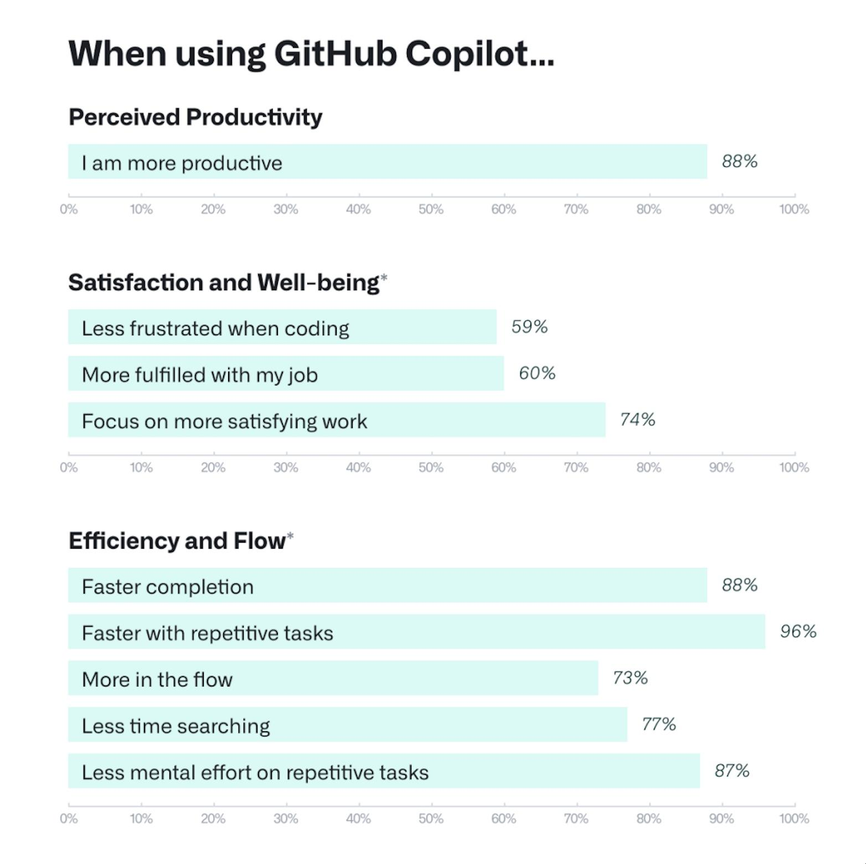
How to quantify GitHub Copilot’s impact on developers
GitHub Offical Servery

Slide 9
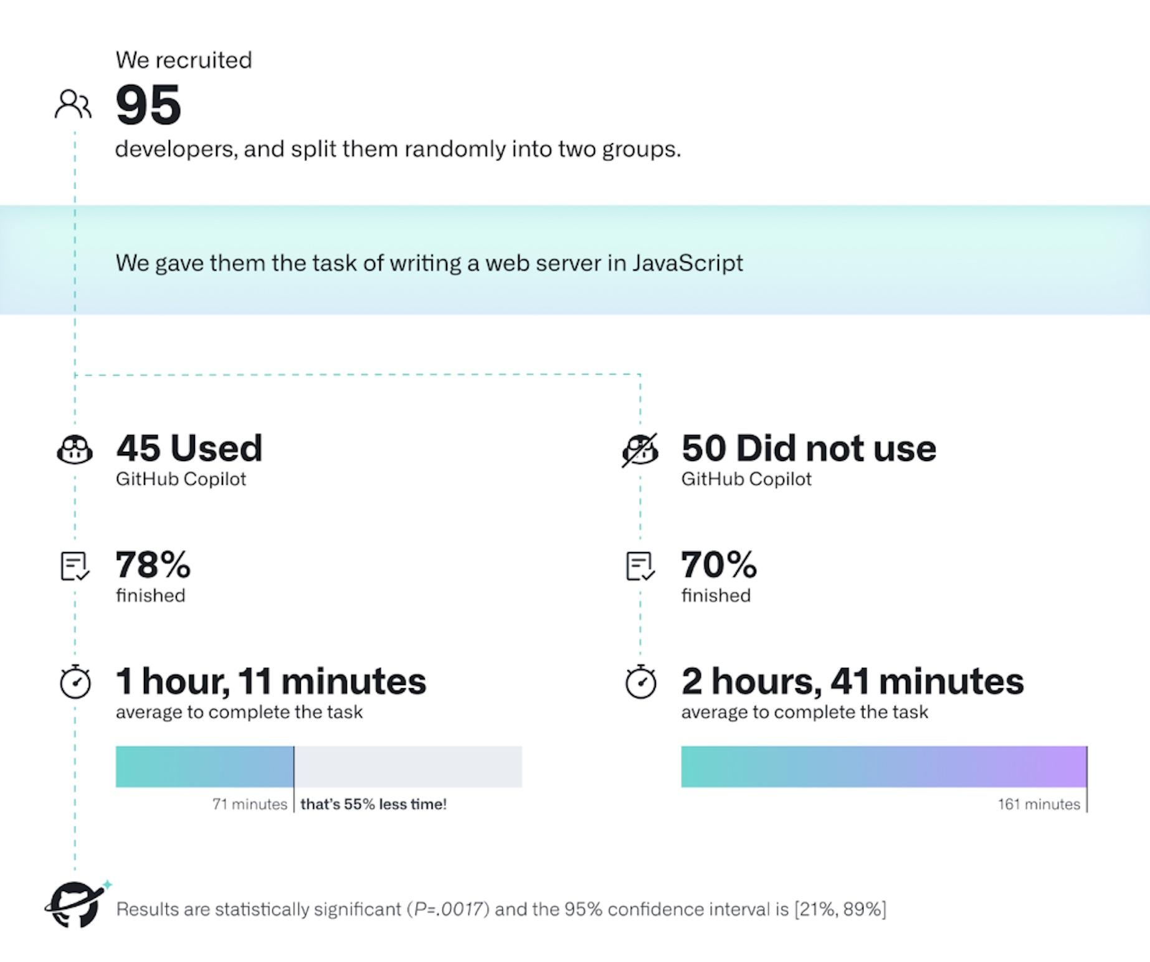
How to quantify GitHub Copilot’s impact on developers
GitHub Offical Servery
Notes:
GitHub Copilot 支持更快的完成时间，节省开发人员的精力，帮助他们专注于更令人满意的工作，并最终在编码中找到更多乐趣。GitHub Copilot 支持更快的完成时间，节省开发人员的精力，帮助他们专注于更令人满意的工作，并最终在编码中找到更多乐趣。

Slide 10
How to quantify GitHub Copilot’s impact on developers
GitHub Offical Servery
The striking difference was that developers who used GitHub Copilot completed the task significantly faster–55% faster than the developers who didn’t use GitHub Copilot.
Notes:
GitHub Copilot 支持更快的完成时间，节省开发人员的精力，帮助他们专注于更令人满意的工作，并最终在编码中找到更多乐趣。GitHub Copilot 支持更快的完成时间，节省开发人员的精力，帮助他们专注于更令人满意的工作，并最终在编码中找到更多乐趣。

Slide 11
Summary
Pros
Copilot can quickly generate code snippets, reducing the amount of code developers need to write manually.
Copilot is trained on a large of existing codebases, it often generates well-structured and maintainable code.
Beginners can learn new programming concepts by observing the code generated by Copilot.
Multiple language supporting, developer can read/write unknown language in different project
Cons
Copyright issue
Copilot will retrieve your code and used for training. so if your code is sensitive in your org, better not use it.
Copilot may generate insecure code, may not always generated correct code
Developer coding skill may impacted
External network is required
Excpet JAVA/PYTHON/JS… other language support is not well

Slide 12
Opinions
Individual Productivity VS Team Collaboration
Requirement Analyze
Testing
Coding
Release
Design
TISO
Notes:
以Digital为例，一个产品要上线。至少要有以上的流程，而coding在整个项目周期所处的地位并不高。所以工具会让个人效率提高了，但对整个项目生命周期产生的正面效果并不多。团队协作依然是项目开发中最重要的环节

Slide 13
Opinions
Automation VS Uncertainty
Reduce completion time of certain task thru automation
Simply having more people or higher individual productivity doesn't always resolve the complexities of project management.
《Mythical Man-Month》
Notes:
通过自动化工具容易给PM一种积极乐观的项目进度假象。就像书里面说的“粗暴的加人和提高个人效率并不能完全解决项目的不确定性和复杂性”

Slide 14
Opinions
Efficiency VS Innovation
Tools aims to increase coding efficiency thru auto-completion
Efficiency != Innovation. Using tools can make us focus on completion, but not innovation.
Notes:
工具的目的是快速完成代码编写，提高效率。 而为了完成自动编写，需要对存量代码进行训练，而并不会生产出有创造性的代码。 当我们聚焦在完成任务的时候，创新就会很困难。

Slide 15
Opinions
Learning VS Perfessional
By using tools, everyone can enter to software industry.
Software development requires a deep understanding project management, team collaboration, architecture design.
Notes:
降低了软件开发的入门门槛，使初学者更容易上手。虽然 Copilot 可以帮助初学者快速入门，但它不能替代经验和专业知识。软件开发不仅仅是编写代码，还需要对项目管理、团队协作和软件架构有深入的理解。

Slide 16
Opinions
Others
Refactor, well documentation is requred, code quality, mantenance
Copilot is powerful, but still can’t fully replace traditional software philosophy.
Copilot is so powerful that every developer need to improve software skills
Notes:
工具很好，但是仍然无法影响传统软件开发的理论。 工具太优秀，因此每个人还需要提高自身软实力。

Slide 17
References
Prompt Engineering Guide (https://www.promptingguide.ai/)
Working with the LLMs behind GitHub Copilot(https://github.blog/2023-05-17-inside-github-working-with-the-llms-behind-github-copilot/)
GitHub Copilot (https://github.blog/2023-05-17-how-github-copilot-is-getting-better-at-understanding-your-code/)
GitHub Copilot Quantifying impacts (https://github.blog/2022-09-07-research-quantifying-github-copilots-impact-on-developer-productivity-and-happiness/)
How to use GitHub Copilot (https://github.blog/2023-06-20-how-to-write-better-prompts-for-github-copilot/)
ChatGPT Copilot Extension(https://github.com/feiskyer/chatgpt-copilot )

Slide 18
Thank You

